Slide 1
FINAL ASSESMENT
VENKATA ABHISHEK MUTNURU
4322

Slide 2
QUESTION-1
Cleaned data by checking if any duplicate rows, checked for any null values in data

Slide 3

QUESTION-2
Created a pivot table for published and trending date and found days for the video to trend
Found average of those days

Slide 4
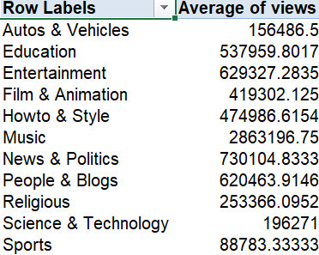
QUESTION-3
Found category name by vlookup and also added a pivot table to that page
Then found average views per category

Slide 5
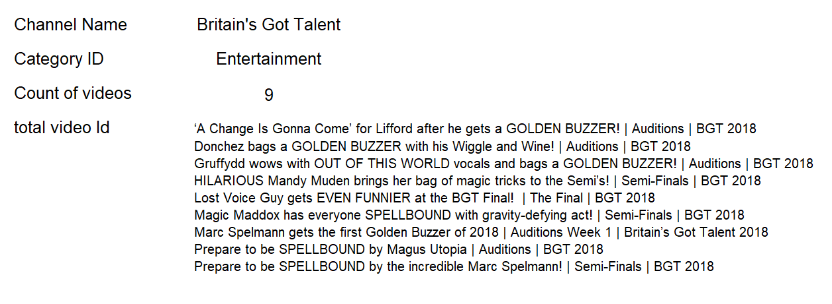
QUESTION-4
Used filter and xlookup to get video titles of a channel they want
And also got count of how many videos per channel

Slide 6
QUESTION-5
Used concat to join title and channel title
CONCAT(A2,B2)
Used text join to join comments and concat value for sentimental analysis
TEXTJOIN(" , ",TRUE,FILTER(C2:D593,C2:C593='Q1'!P2))

Slide 7
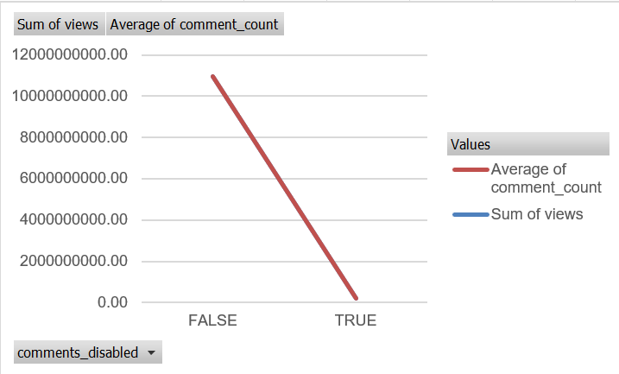

Q-6
Used pivot table to group videos with comments disabled
We can analyse that videos with comments enabled are having more number of views compared to other.

Slide 8
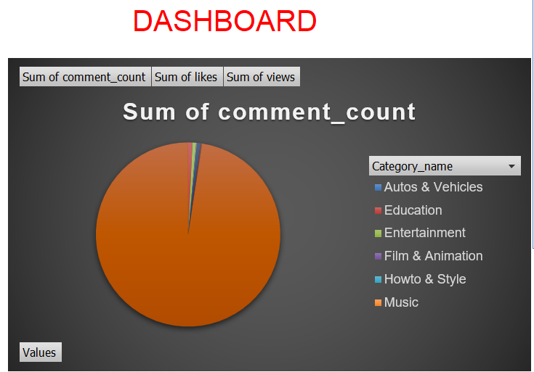
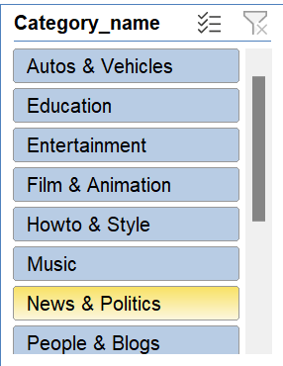
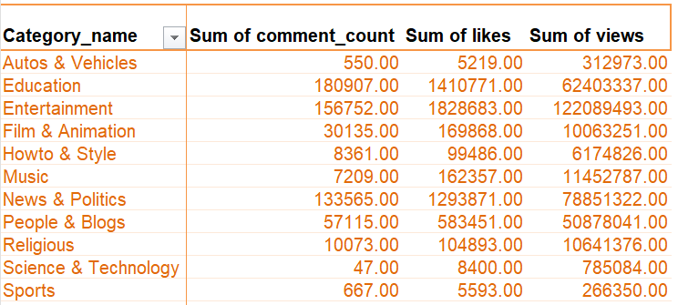
Q-7

Slide 9
Q-8
Sorted and grouped according to category name and highlighted top 5 items in every category by views

Slide 10
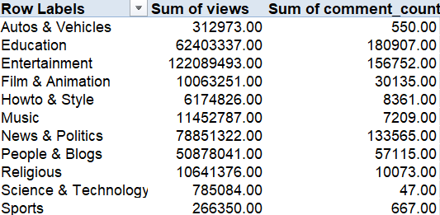
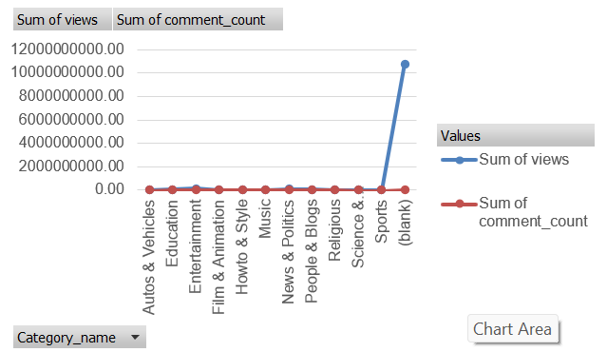
Q-9
Inserted a pivot table and drew analysis from it
We can draw some conclusions from this data that highest number of views are to entertainment category
Least number of likes are for science and technology sector

Slide 11
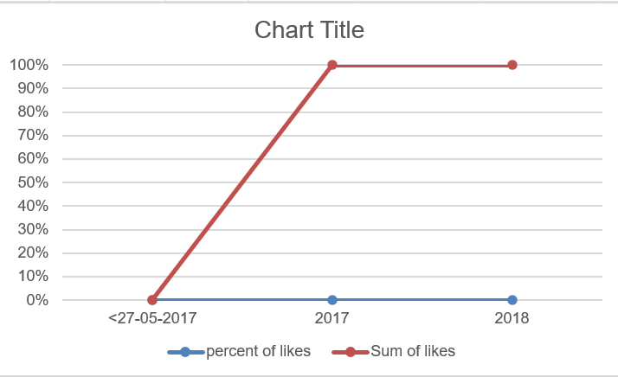
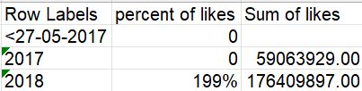
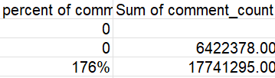

Q-10
percent of likes increased compared to the last year by 199% on an average
percent of sum_of_views increased compared to the last year by 213% on an average
percent of comment_count increased compared to the last year by 176% on an average
Created a pivot table and gathered some insights on it

Slide 12
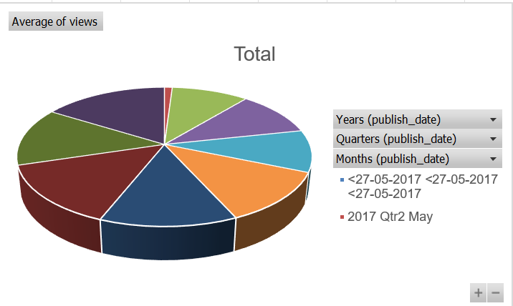
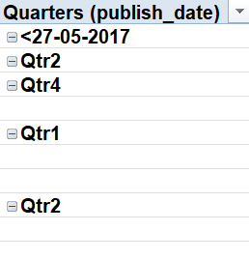
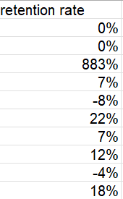
Q-11
Cohort analysis
We can analysis the retention rates from above figures by quarter by youtube channels
User engagement goes like an AC current. By the end there were able to regain them with 18%.

Slide 13
Q-12
Estimated that youtube gives revenue based on views
There is INR 2 for each video’s view
So I calculated revenue by multiplying views with revenue per view
YouTube Spotlight channel got highest revenue as per my caluculation. YouTube Rewind: The Shape of 2017 | #YouTubeRewind this is the title of this video.
Zee Yuva this channel got least revenue. 8048 collected this much money

Slide 14
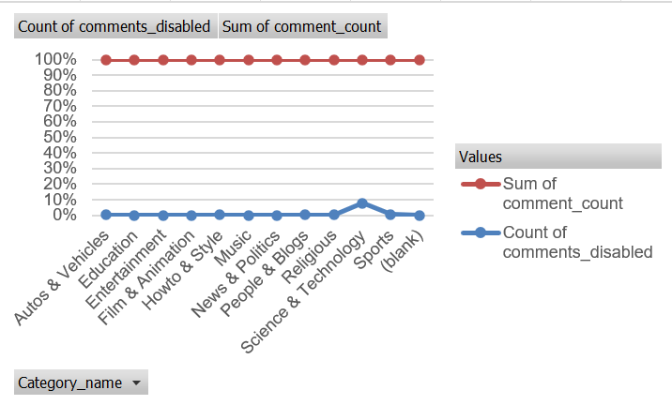
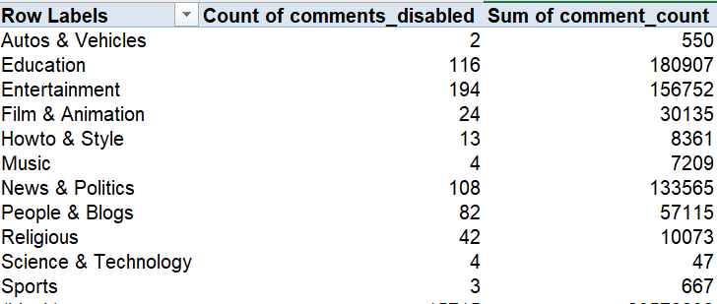
Q-13
Created a pivot table and analyzed the values
We can analyse sentimental analysis of comments by this information.
Science and technology lags behind amongst all categories

Slide 15
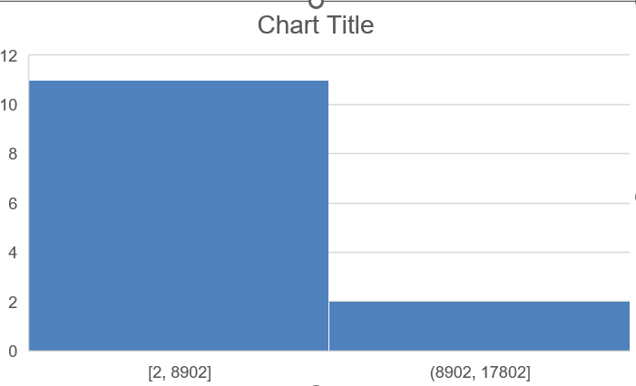
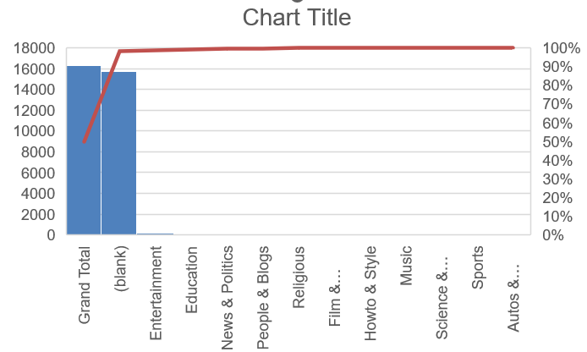
Q-14
Here the comparison is done between all categories by the viewership in different countries shown by histogram
Here we created chats to view that Autos and vehicles are least viewed in diff countries

Slide 16
Dashboard

Slide 17
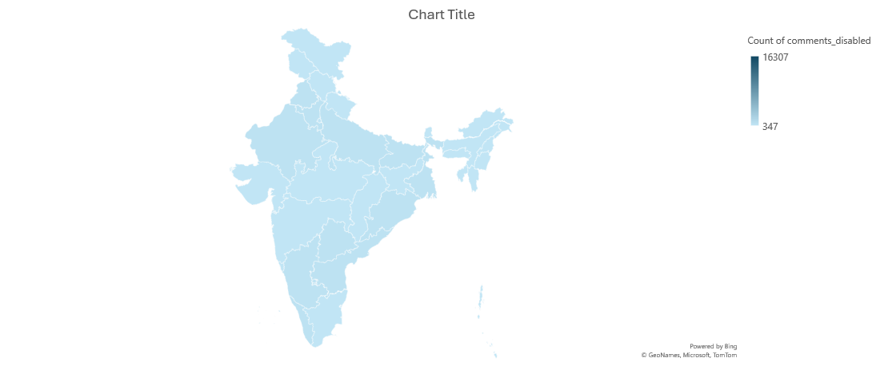

Slide 21
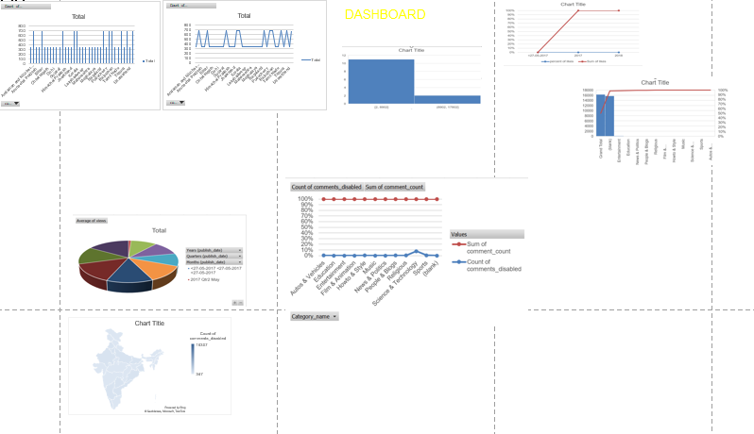
Final Dashboard

